Slide 1
CHAPTER
33
Aggregate Demand
and Aggregate Supply
Notes:
This is perhaps the most important of the macro chapters. It develops the model of aggregate demand and aggregate supply, a paradigm that is widely used by many economists, policymakers, journalists, and business people. Mastering this chapter will give students much insight into how the world works, and will make the following two chapters easier to learn.
Most students find this to be one of the most challenging chapters in the textbook. However, much of the material here should be familiar from previous chapters—e.g., the Classical Dichotomy, the relationship between investment and interest rates, the relationship between net exports and the exchange rate. This chapter brings together much of this familiar material in a new context, which allows us to address new and important questions, such as: what causes recessions, and what can policymakers do to alleviate recessions?

Slide 2
Look for the answers to these questions:
What are economic fluctuations? What are their characteristics?
How does the model of aggregate demand and aggregate supply explain economic fluctuations?
Why does the Aggregate-Demand curve slope downward? What shifts the AD curve?
What is the slope of the Aggregate-Supply curve in the short run? In the long run? What shifts the AS curve(s)?

Slide 3
景氣循環 (Busyness cycles)
景氣循環是一種國家總體性經濟活動的波動，一個循環是指許多經濟活動大約同時發生擴張，隨後發生收縮、衰退，然後又開始復甦的情形。這一連串的波動會週而復始但不定期的發生，其持續期間由一年以上到十年不等。

Slide 4
一個景氣循環週期包含
一個擴張期(expansion，即介於景氣谷底(trough)至景氣高峰(peak)之期間)及
一個收縮期(contraction，即介於景氣高峰至景氣谷底之期間)。
實務上，擴張期及收縮期個別應持續至少5個月，全循環至少需15個

Slide 5
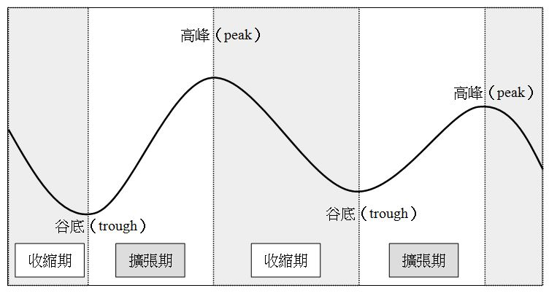

Slide 6
所謂景氣循環的基準日期（the reference date of business cycle）是指總體經濟波動高峰及谷底的時點。

Slide 7
我國景氣基準日期之認定:
1. 選取一組代表性經濟指標，綜合為一基準循環數列，並參酌個別代表性指標表現，以判斷景氣基準日期。
2. 景氣峰谷認定工作，亦由生產、消費、就業、貿易、交易等代表性數列編製擴散指數，以輔佐景氣基準日期之判斷。
3. 最後邀集各界專家學者討論，完成峰谷日期之認定。

Slide 8
Introduction
Real GDP over the long run
Grows about 3% per year on average
GDP in the short run
Fluctuates around its trend
Recessions
Periods of falling real incomes and rising unemployment
Depressions
Severe recessions (very rare)
Notes:
Explaining these fluctuations is difficult, and the theory of economic fluctuations is controversial.
Most economists use the model of aggregate demand and aggregate supply to study fluctuations. This model differs from the classical economic theories economists use to explain the long run.

Slide 9
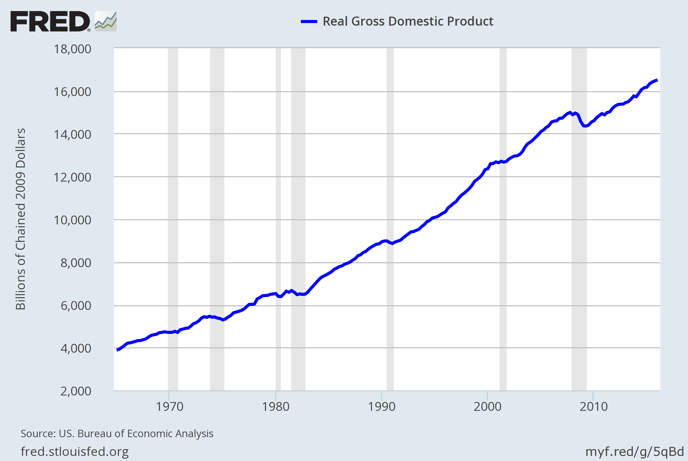
Three Facts About Economic Fluctuations
FACT 1: Economic fluctuations are irregular and unpredictable
Notes:
U.S. real GDP, billions of 2009 dollars, 1965 – 2015.
Recessions (represented by the shaded bars) are of different durations and do not occur with any regularity. Hence, the common term “business cycle” is a bit misleading, as “cycle” implies something more regular and predictable.
ORIGINAL SOURCE: U.S. Department of Commerce, Bureau of Economic Analysis
Website where I found this data: http://research.stlouisfed.org/fred2/
SERIES: GDPC1
Updated data and graph at: https://fred.stlouisfed.org/graph/?g=5qB5 (download the graph as PowerPoint and copy-paste the figure)

Slide 10
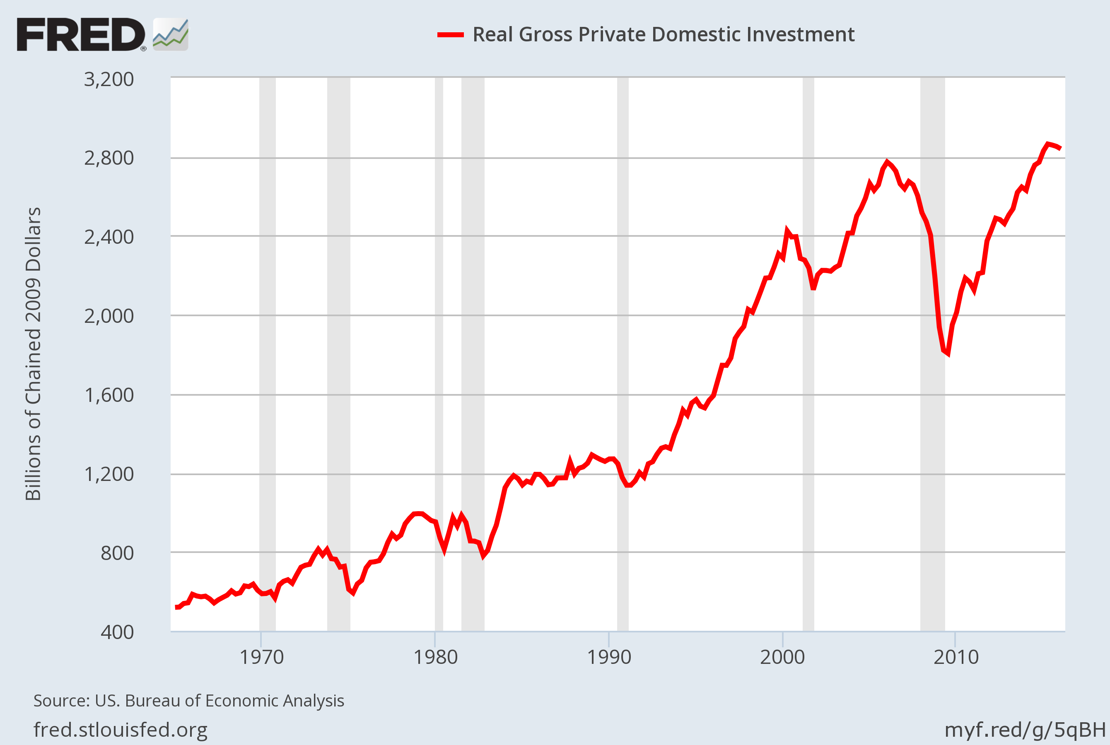
Three Facts About Economic Fluctuations
FACT 2: Most macroeconomic quantities fluctuate together.
Notes:
Investment spending, billions of 2009 dollars, 1965-2015.
Point out that investment falls during each recession. This is true of other variables as well: When the economy is in recession, incomes fall, consumer spending falls, profits fall, many stock prices fall, tax revenue falls (causing the budget deficit to rise), and spending on imports falls (causing the trade deficit to shrink).
ORIGINAL SOURCE: U.S. Department of Commerce, Bureau of Economic Analysis
Website where I found this data: http://research.stlouisfed.org/fred2/
SERIES NAME: GPDIC1
Updated data and graph at https://fred.stlouisfed.org/graph/?g=5qBG (download the graph as PowerPoint and copy-paste the figure)

Slide 11
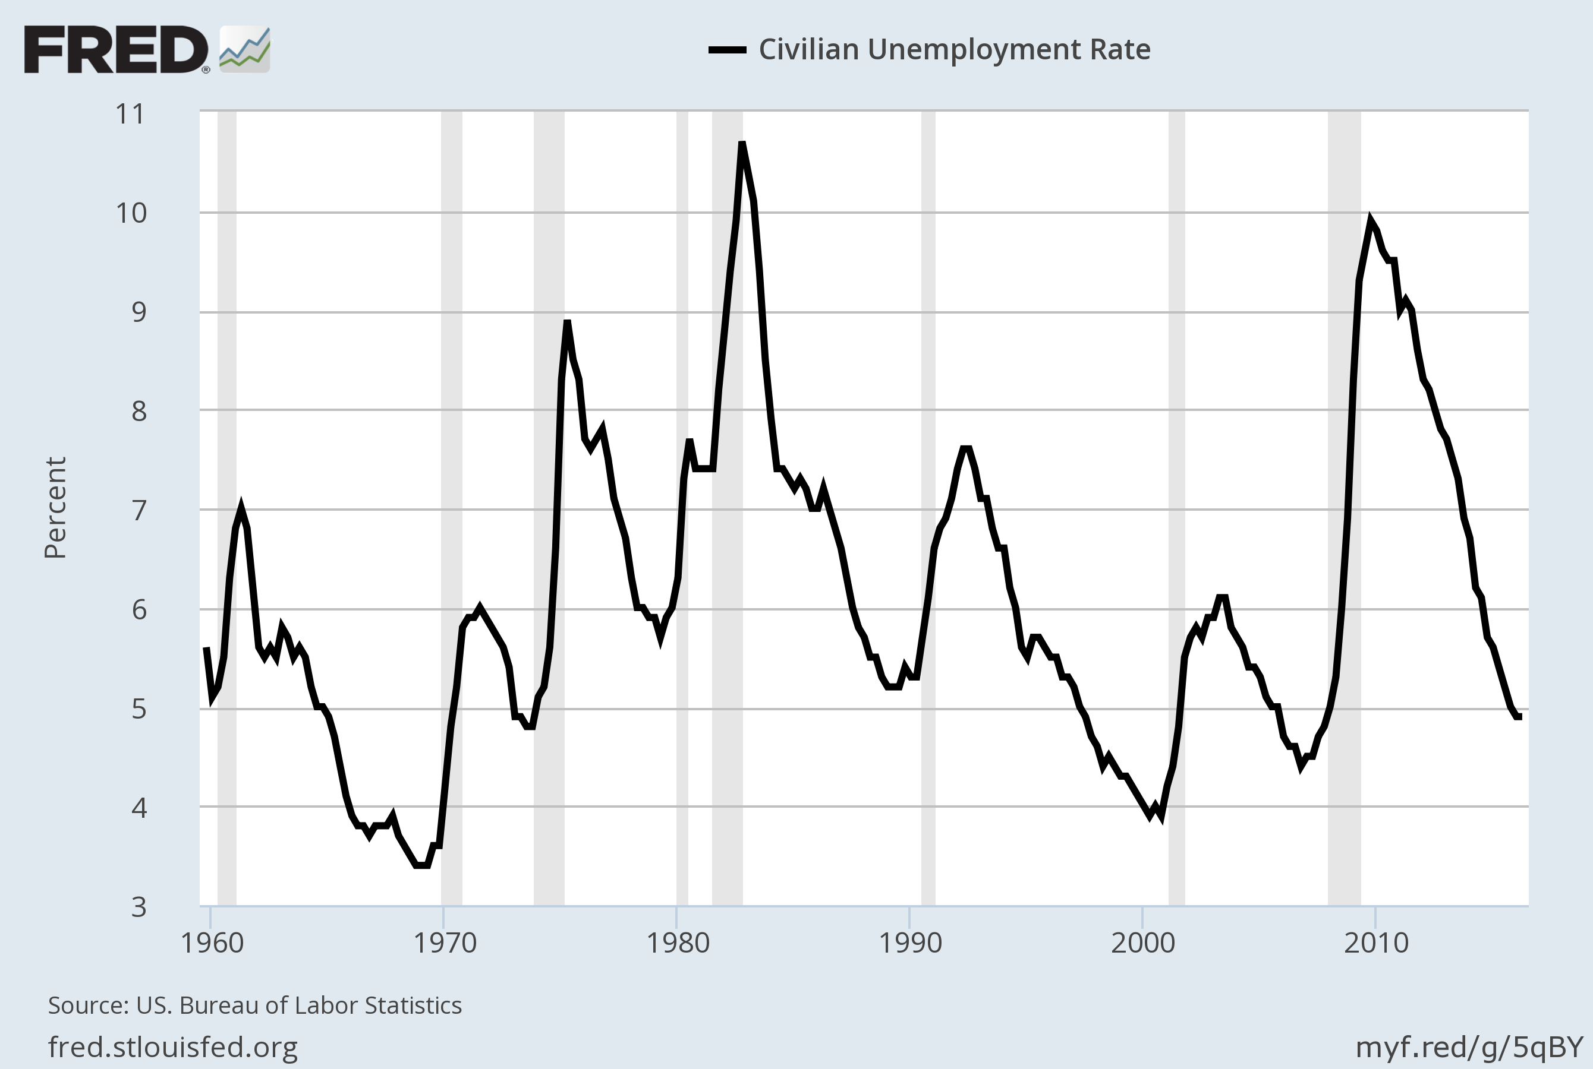
Three Facts About Economic Fluctuations
FACT 3: As output falls, unemployment rises.
Notes:
Unemployment rate, percent of labor force, 1965-2015.
During each recession, the unemployment rate rises. When firms cut back on production, they don’t need as many workers. Similarly, during expansions, we see the unemployment rate falling—as firms increase their output, they need more workers.
ORIGINAL SOURCE: U.S. Department of Labor, Bureau of Labor Statistics
Website where I found this data: http://research.stlouisfed.org/fred2/ series “UNRATE” (quarterly, average, seasonally adjusted)
Updated data and graph at https://fred.stlouisfed.org/graph/?g=5qBX (download the graph as PowerPoint and copy-paste the figure)

Slide 12
Classical Economics—A Recap
Classical economics:
The Classical Dichotomy, the separation of variables into two groups:
Real – quantities, relative prices
Nominal – measured in terms of money
The neutrality of money: Changes in the money supply affect nominal but not real variables
Notes:
If you have covered the long-run chapters before this one, then your students have seen these terms already. It may be worth reminding your students that the Classical Dichotomy is what allowed us to study the real variables (like real GDP and its growth rate, the unemployment rate, investment, and the real wage) in separate chapters before we introduced nominal variables (like the price level and money supply).

Slide 13
Classical Economics—A Recap
Classical theory
Describes the world in the long run, but not the short run
In the short run
Changes in nominal variables (like the money supply or P ) can affect real variables (like Y or the u-rate).
We use a new model…
Notes:
As in previous chapters, “u-rate” is short for unemployment rate.

Slide 14
Model of Aggregate Demand and Aggregate Supply
0
P
“Short-Run Aggregate Supply”
The price level
SRAS
The model determines the equilibrium price level
P₁
AD
“Aggregate Demand”
Y
Y₁
and equilibrium output (real GDP).
Real GDP, the quantity of output
Notes:
14
Suggestion: Briefly explain each element of the graph as it appears. (Brief is appropriate because each element will be discussed carefully in the following slides.)
Note that the graph measures a nominal variable (P) on the vertical axis, and a real one (Y) on the horizontal axis. Thus, the graph highlights the breakdown of the classical dichotomy.
If you are more of a micro person, then please disregard the following.
Still reading? Then you must be a macro person. Excellent! Here’s something you might tell your students. This model LOOKS like the basic supply and demand model from Chapter 4, but there’s a big difference. The basic supply & demand model determines the equilibrium price and quantity of a particular good, say, apples. The equilibrium price of apples is extremely important if you’re an apple grower. Ask your students to raise their hand if they plan on going into the apple-growing business. Chances are, none will raise their hands. The model of aggregate demand and supply, however, determines the equilibrium price and quantity of EVERYTHING (loosely speaking), i.e., the price level (cost of living) and real GDP (national income). So, the model of aggregate demand and aggregate supply is highly relevant to a broader group of people than just apple growers. How ’bout them apples!

Slide 15
The Aggregate-Demand (AD) Curve
0
The AD curve shows the quantity of all goods and services demanded in the economy at any given price level.
P
P₂
P₁
AD
Y
Y₂
Y₁
Notes:
15
As in previous chapters, “g&s” stands for “goods and services.”

Slide 16
Why the AD Curve Slopes Downward
0
Y = C + I + G + NX
Assume G is fixed by government policy.
To understand the slope of AD, must determine how a change in P affects C, I, and NX.
P
P₂
P₁
AD
Y
Y₂
Y₁
Y₁
Notes:
16

Slide 17
The Wealth Effect (P and C )
Suppose the price level, P, declines
Increase in the real value of money
Consumers are wealthier
Increase in consumer spending, C
Increase in quantity demanded of goods and services
Notes:
Note: the wealth effect concerns the impact of a change in P on wealth, not on income. When P falls, we are implicitly assuming that people’s real incomes are unchanged, and we are only considering the impact of the change in their real wealth on their consumption spending.
After all text on this slide has appeared, you might tell your students that this effect works in reverse, too: increase in P declines real wealth, which causes consumption to drop.

Slide 18
The Interest-Rate Effect (P and I)
Suppose the price level, P, declines
Buying goods and services requires fewer dollars
People buy bonds and other assets
Decrease in the interest rate
Increase spending on investment goods, I
Increase in quantity demanded of goods and services
Notes:
Again, we are holding real income (and everything else) constant.
At this point, some students will not understand why an increase in household demand for bonds causes interest rates to fall. If you wish, you can explain it now, or you can tell them not to worry about it for now—it will be covered in more detail in the following chapter (in the section on the Liquidity Preference Theory).
After all the text on this slide has appeared, you might tell your students that the interest-rate effect also works in reverse: an increase in P causes an increase in interest rates, which decreases investment.

Slide 19
The Exchange-Rate Effect (P and NX )
Suppose the U.S. price level, P, declines
Decrease in the interest rate
U.S. dollar depreciates
Stimulates U.S. net exports, NX
Increase in quantity demanded of goods and services
Notes:
Again, the exchange-rate effect also works in reverse: An increase in P causes interest rates and exchange rates to increase, which decreases NX:
Suppose P rises: U.S. interest rates rise (the interest-rate effect); Foreign investors desire more U.S. bonds; Higher demand for $ in foreign exchange market; U.S. exchange rate appreciates; U.S. exports more expensive to people abroad, imports cheaper to U.S. residents. Result: NX falls.

Slide 20
The Slope of the AD Curve: Summary
0
An increase in P reduces the quantity of goods and services demanded because:
the wealth effect (C falls)
the interest-rate effect (I falls)
the exchange-rate effect (NX falls)
P
P₂
P₁
AD
Y
Y₂
Y₁
Notes:
20
Note that the red arrow is not equal to the fall in C, but rather to the fall in demand due to the fall in C. The difference is due to the Keynesian multiplier: the initial fall in C causes a fall in Y, which causes a further (but smaller) fall in C, which causes a further (but smaller) fall in Y, and so forth. It might not be appropriate to cover the Keynesian multiplier at this point—it will be discussed in the following chapter—but mentioning that the red arrow is not the same as the fall in C might prevent students from learning something they will later have to unlearn. Similarly, the green arrow represents not the fall in I, but the fall in demand due to the fall in I. And similarly for the brown arrow and NX.

Slide 21
Why the AD Curve Might Shift
0
Any event that changes C, I, G, or NX—except a change in P—will shift the AD curve.
Example: A stock market boom makes households feel wealthier, C rises, the AD curve shifts right.
P
P₁
AD₂
AD₁
Y
Y₁
Y₂
Notes:
21
A change in P won’t shift the AD curve, but will cause a movement along the AD curve.

Slide 22
Why the AD Curve Might Shift
Changes in C
Stock market boom/crash
Preferences re: consumption/saving tradeoff
Tax hikes/cuts
Changes in I
Firms buy new computers, equipment, factories
Expectations, optimism/pessimism
Interest rates,
Monetary policy,
Investment Tax Credit or other tax incentives
Notes:
You should probably o mention that any changes leading to increasing C, I, G, or NX lead to an increase in AD (so the AD curve shifts right)

Slide 23
Why the AD Curve Might Shift
Changes in G
Federal spending, e.g., defense
State & local spending, e.g., roads, schools
Changes in NX
Booms/recessions in countries that buy our exports
Appreciation/depreciation resulting from international speculation in foreign exchange market

Slide 24
Active Learning 1 The Aggregate-Demand curve
What happens to the AD curve in each of the following scenarios?
A ten-year-old investment tax credit expires.
The U.S. exchange rate falls.
A fall in prices increases the real value of consumers’ wealth.
State governments replace their sales taxes with new taxes on interest, dividends, and capital gains.
Notes:
Suggestion: Have your students draw a separate diagram of the AD curve for each scenario and show on the diagram what happens to the curve.

Slide 25
Active Learning 1 Answers
A ten-year-old investment tax credit expires.
I falls, AD curve shifts left.
The U.S. exchange rate falls.
NX rises, AD curve shifts right.
A fall in prices increases the real value of consumers’ wealth.
Move down along AD curve (wealth-effect).
State governments replace their sales taxes with new taxes on interest, dividends, and capital gains.
C rises, AD shifts right.

Slide 26
The Aggregate-Supply (AS ) Curves
0
The AS curve shows the total quantity of goods and services firms produce and sell at any given price level.
AS is:
upward-sloping in short run
vertical in long run
P
LRAS
SRAS
Y
Notes:
26

Slide 27
The Long-Run Aggregate-Supply Curve (LRAS)
0
The natural rate of output (Y_{N}) is the amount of output the economy produces when unemployment is at its natural rate.
Also called
potential output or full-employment output.
P
LRAS
Y
Y_{N}
Notes:
27
The book does not use the notation Y_{N}. I use it here to keep the slides from getting too cluttered and to make it easier for students to take notes.

Slide 28
Why LRAS Is Vertical
0
Y_{N} determined by the economy’s stocks of labor, capital, and natural resources, and on the level of technology.
An increase in P
does not affect any of these, so it does not affect Y_{N}.
(Classical dichotomy)
P
LRAS
P₂
P₁
Y
Y_{N}
Notes:
28
This is review from the chapter “Production and Growth.”

Slide 29
Why the LRAS Curve Might Shift
0
Any event that changes any of the determinants of Y_{N} will shift LRAS.
Example: Immigration increases L, causing Y_{N} to rise.
P
LRAS₁
LRAS₂
Y
Y_{N}
’
Y_{N}
Notes:
29

Slide 30
Why the LRAS Curve Might Shift
Changes in L or natural rate of unemployment
Immigration
Baby-boomers retire
Government policies reduce natural u-rate
Changes in K or H
Investment in factories, equipment
More people get college degrees
Factories destroyed by a hurricane
Notes:
Remember: L = labor; K = capital, H = human capital

Slide 31
Why the LRAS Curve Might Shift
Changes in natural resources
Discovery of new mineral deposits
Reduction in supply of imported oil
Changing weather patterns that affect agricultural production
Changes in technology
Productivity improvements from technological progress
Notes:
It might be worth mentioning that the change in weather patterns or reduction in imported resources would have to be reasonably long-lasting for the LRAS curve to shift. Short-lived changes are more likely to affect SRAS than LRAS.

Slide 32
Using AD & AS to Depict Long-Run Growth & Inflation
0
Over the long run, tech. progress shifts LRAS to the right
and growth in the money supply shifts AD to the right.
Result: ongoing inflation and growth in output.
LRAS₂₀₁₀
P
LRAS₂₀₀₀
LRAS₁₉₉₀
P₂₀₁₀
P₂₀₀₀
AD₂₀₁₀
P₁₉₉₀
AD₂₀₀₀
AD₁₉₉₀
Y
Y₁₉₉₀
Y₂₀₀₀
Y₂₀₁₀
Notes:
32
In the following chapter, it will be more clear why money supply growth shifts the AD curve rightward.

Slide 33
Short Run Aggregate Supply (SRAS)
0
The SRAS curve is upward sloping:
Over the period of 1–2 years, an increase in P
causes an increase in the quantity of goods and services supplied.
P
SRAS
P₂
P₁
Y
Y₁
Y₂
Notes:
33

Slide 34
Why the Slope of SRAS Matters
0
If AS is vertical, fluctuations in AD do not cause fluctuations in output or employment.
If AS slopes up, then shifts in AD do affect output and employment.
LRAS
P
P_{hi}
SRAS
P_{hi}
AD_{hi}
P_{lo}
AD₁
P_{lo}
AD_{lo}
Y
Y_{lo}
Y₁
Y_{hi}
Notes:
34
Before introducing the three theories of short-run aggregate supply, it’s worth taking a moment to show students why the slope of SRAS is critically important in the theory of economic fluctuations.

Slide 35
Three Theories of SRAS
Theories that explain why the AS curve slopes upward in short-run:
Sticky-wage theory
Sticky-price theory
Misperceptions theory
In each, some type of market imperfection: Output deviates from its natural rate when the actual price level deviates from the price level people expected.
Notes:
Each of these theories provides a reason why the aggregate supply curve might have a positive slope in the short run.
It would be most helpful if students carefully read this section of the chapter!

Slide 36
1. The Sticky-Wage Theory
Imperfection:
Nominal wages are sticky in the short run, they adjust sluggishly.
Due to labor contracts, social norms
Firms and workers set the nominal wage in advance based on P_{E}, the price level they expect to prevail.

Slide 37
1. The Sticky-Wage Theory
If P > P_{E},
Revenue is higher, but labor cost is not.
Production is more profitable, so firms increase output and employment.
Hence, higher P causes higher Y, so the SRAS curve slopes upward.
Notes:
“If P > PE” means “If the actual price level turns out to be higher than the price level firms had expected...”

Slide 38
2. The Sticky-Price Theory
Imperfection:
Many prices are sticky in the short run.
Due to menu costs, the costs of adjusting prices.
Examples: cost of printing new menus, the time required to change price tags
Firms set sticky prices in advance based on P_{E}

Slide 39
2. The Sticky-Price Theory
Suppose the Fed increases the money supply unexpectedly
In the long run, P will rise
In the short run:
Firms without menu costs can raise their prices immediately
Firms with menu costs wait to raise prices. With relatively low prices: increase demand for their products: increase output and employment
Hence, higher P is associated with higher Y, so the SRAS curve slopes upward.

Slide 40
3. The Misperceptions Theory
Imperfection:
Firms may confuse changes in P with changes in the relative price of the products they sell.
If P rises above P_{E}
A firm sees its price rise before realizing all prices are rising.
The firm may believe its relative price is rising, and may increase output and employment.
So, an increase in P can cause an increase in Y, making the SRAS curve upward-sloping.
Notes:
The following remarks are not officially part of the textbook and therefore not supported in the study guide or test bank.
Of the three theories, this one seems the least plausible. Firms certainly have a strong incentive to not mistake a general price increase for a relative price increase. And information about the price level is costless and available with only a short lag (especially the CPI, which is published monthly and very widely reported the moment it comes out).

Slide 41
What the 3 Theories Have in Common:
In all 3 theories, Y deviates from Y_{N} when P deviates from P_{E}.
Y = Y_{N} + a (P – P_{E})
Output
Expected price level
Natural rate of output (long-run)
a > 0, measures how much Y responds to unexpected changes in P
Actual price level
Notes:
Economists debate which of these theories is correct. It’s possible that each of them contains some element of truth.
For our purposes here, the similarities between these theories are more important than their differences: all three imply that output deviates from its long-run level (the “natural rate of output”) when the price level (P) deviates from the level people had expected (P_{E}).

Slide 42
What the 3 Theories Have in Common:
Y = Y_{N} + a (P – P_{E})
0
P
SRAS
When P > P_{E}
the expected price level
P_{E}
When P < P_{E}
Y
Y_{N}
Y < Y_{N}
Y > Y_{N}
Notes:
42
The preceding slide introduced an equation of aggregate supply that shows how output deviates from full-employment when the actual price level is different than expected.
This slide illustrates these concepts using a graph.
When P = P_{E}, Y = Y_{N}
When P < P_{E}, Y < Y_{N}
When P > P_{E}, Y > Y_{N}

Slide 43
SRAS and LRAS
The imperfections in these theories are temporary. Over time,
Sticky wages and prices become flexible
Misperceptions are corrected
In the LR,
P_{E} = P
AS curve is vertical

Slide 44
SRAS and LRAS
0
Y = Y_{N} + a (P – P_{E})
In the long run, P_{E} = P
and Y = Y_{N}.
P
LRAS
SRAS
P_{E}
Y
Y_{N}
Notes:
44
Notice that when the price level equals the expected price level, output is equal to its long-run value, the natural rate of output.
Interpretation:
In the short run, people may be fooled about the price level, or they may be locked into wages or prices that were set before they knew what the price level would actually be. Hence, in the short run, P may differ from P_{E}.
But in the long run, expectations catch up to reality, P = P_{E}, and therefore Y = Y_{N}, as in the Classical model.
Thus, our theory of economic fluctuations is basically the Classical model (which we studied for several chapters) augmented with some kind of market imperfection (such as sticky wages). The impact of the market imperfection occurs only in the short run, so the long-run behavior of our model is Classical.

Slide 45
Why the SRAS Curve Might Shift
0
Everything that shifts LRAS shifts SRAS, too.
Also, P_{E} shifts SRAS:
If P_{E} rises,
workers & firms set higher wages.
At each P, production is less profitable, Y falls, SRAS shifts left.
P
LRAS
SRAS
SRAS
P_{E}
P_{E}
Y
Y_{N}
Notes:
45

Slide 46
The Long-Run Equilibrium
0
In the long-run equilibrium,
P_{E} = P,
Y = Y_{N} ,
and unemployment is at its natural rate.
P
LRAS
SRAS
P_{E}
AD
Y
Y_{N}
Notes:
46

Slide 47
Economic Fluctuations
Four steps to analyzing economic fluctuations:
Determine whether the event shifts AD or AS.
Determine whether curve shifts left or right.
Use AD–AS diagram to see how the shift changes Y and P in the short run.
Use AD–AS diagram to see how economy moves from new SR equilibrium to new LR equilibrium .
Notes:
To study economic fluctuations caused by events that shift the AD and/or AS curves, we use the four-step approach based on the three-step approach used in Chapter 4 to analyze changes in the basic supply & demand model.

Slide 48
The Effects of a Shift in AD
0
Event: Stock market crash
1. Affects C, AD curve
2. C falls, so AD shifts left
3. SR equilibrium at B. P and Y lower, unemployment higher
4. Over time, P_{E} falls, SRAS shifts right, until LR equilibrium at C. Y and unemployment back at initial levels.
P
LRAS
SRAS₁
P₁
A
SRAS₂
P₂
B
AD₁
P₃
C
AD₂
Y
Y₂
Y_{N}
Notes:
48
The results from this exercise apply to any event that shifts AD to the left, whether a stock market crash, recession abroad, wave of pessimism, or other.
The stock market crash reduces consumers’ wealth, which depresses their spending. The AD curve shifts to the left.
The new short-run equilibrium is at point B, where P and Y are lower, and hence unemployment is higher. (Remember Fact #3 about economic fluctuations: unemployment and output move in opposite directions.)
At point B, P < P_{E}. Over time, P_{E} falls, wages fall, and sticky prices become flexible and fall. The SRAS curve moves rightward.
This process continues until the economy arrives at point C, where GDP and unemployment are back at their natural rates, and P_{E} = P once again.
Notice that, in the absence of policy intervention, the economy “self-corrects.” Of course, this process takes time, and policymakers may not want to wait. At point B, policymakers could use fiscal or monetary policy to shift aggregate demand to the right and move the economy back to A.

Slide 49
Two Big AD Shifts: 1.The Great Depression
From 1929–1933, money supply fell 28% due to problems in banking system
stock prices fell 90%, reducing C and I
Y fell 27%
P fell 22%
Unemployment rate rose from 3% to 25%
U.S. Real GDP, billions of 2000 dollars
Notes:
Two possible causes of the Great Depression: the fall in the money supply, and the stock market crash. Either would shift the AD curve left, causing P and Y to fall and causing unemployment to rise.
Data source: Bureau of Economic Analysis, U.S. Department of Commerce
http://www.bea.doc.gov/bea/dn/home/gdp.htm

Slide 50
Two Big AD Shifts: 2.The World War II Boom
From 1939–1944,
government outlays rose from $9.1 billion to $91.3 billion
Y rose 90%
P rose 20%
unemployment fell from 17% to 1%
U.S. Real GDP, billions of 2000 dollars
Notes:
This boom was clearly caused by a surge in govt spending. Our model predicts an increase in G would shift AD to the right, increasing P and Y, and reducing unemployment. These predictions are consistent with the data.
Source for GDP data: Bureau of Economic Analysis, U.S. Department of Commerce
http://www.bea.doc.gov/bea/dn/home/gdp.htm
Source for data on government outlays: Economic Report of the President, 2005 edition, Table B-78. http://www.gpoaccess.gov/eop/

Slide 51
Active Learning 2 Working with the model
Draw the AD-SRAS-LRAS diagram for the U.S. economy starting in a long-run equilibrium.
A boom occurs in Canada. Use your diagram to determine the SR and LR effects on U.S. GDP, the price level, and unemployment.

Slide 52
Active Learning 2 Answers
Event: Boom in Canada
Affects NX, AD curve
Shifts AD right
SR equilibrium at point B. P and Y higher, unemployment lower
Over time, PE rises, SRAS shifts left, until LR equilibrium at C. Y and unemployment back at initial levels.
P
LRAS
SRAS₂
P₃
C
SRAS₁
P₂
B
P₁
A
AD₂
AD₁
Y
Y_{N}
Y₂
Notes:
The boom in Canada increases the incomes of Canadian consumers. In turn, their spending rises. Some of their spending is on products from the U.S., so their spending increase causes U.S. exports to rise.
This shifts the U.S. AD curve to the right. The new short-run equilibrium is at point B, where P and Y are higher, and hence unemployment is lower.
At B, P > P_{E}. Over time, P_{E} rises, wages rise, and sticky prices become flexible and rise. The SRAS curve moves leftward.
This process continues until the economy arrives at point C, where GDP and unemployment are back at their natural rates and expectations about P have caught up to reality.

Slide 53
The Great Recession of 2008–2009
Large contractionary shift in AD
Real GDP fell sharply
By 4.2% between the forth quarter of 2007 and the second quarter of 2009
Employment fell sharply
Unemployment rate rose from 4.4% in May 2007 to 10.0% in October 2009
The housing market played a central role in this recession…
Notes:
Source of GDP and unemployment data: textbook

Slide 54
CASE STUDY: The Great Recession of 2008–2009
Case-Shiller Home Price Index
2000 = 100
Notes:
Data: The Case-Shiller 20-city composite index, seasonally adjusted, monthly
Source: http://www.standardandpoors.com/indices/sp-case-shiller-home-price-indices/en/us/?indexId=spusa-cashpidff--p-us----
The cities in this index have, on average, more extreme price movement than the country as a whole.
For an excellent (though very conservative) discussion of these issues, see The Housing Boom and Bust (revised and updated edition) by Thomas Sowell.

Slide 55
The Great Recession of 2008–2009
Rising house prices during 2002–2006 due to:
Low interest rates
Easier credit for “sub-prime” borrowers
Government policies to increase homeownership
Securitization of mortgages

Slide 56
The Great Recession of 2008–2009
Securitization of mortgages:
Investment banks purchased mortgages from lenders,
Created securities backed by these mortgages,
Sold the securities to banks, insurance companies, and other investors.
Mortgage-backed securities perceived as safe, since house prices “never fall”

Slide 57
The Great Recession of 2008–2009
Consequences of 2006–2009 housing market crash:
Millions of homeowners “underwater”—owed more than house was worth.
Millions of mortgage defaults and foreclosures.
Banks selling foreclosed houses increased surplus and downward price pressures.
Housing crash badly damaged construction industry: 2010 unemployment rate was 20.6% in construction vs. 9.6% overall.
Notes:
Source of construction and overall unemployment rates:
BLS.gov, “Characteristics of the Unemployed”
ftp://ftp.bls.gov/pub/special.requests/lf/aat26.txt

Slide 58
The Great Recession of 2008–2009
Consequences of 2006–2009 housing market crash:
Mortgage-backed securities became “toxic,”
Heavy losses for institutions that purchased them,
Widespread failures of banks and other financial institutions.
Sharply rising unemployment and falling GDP.

Slide 59
The Great Recession of 2008–2009
The policy response:
Federal Reserve reduced Fed Funds rate target to near zero.
Federal Reserve purchased mortgage-backed securities and other private loans.
U.S. Treasury injected capital into the banking system to increase banks’ liquidity and solvency in hopes of staving off a “credit crunch.”
Fiscal policymakers increased government spending and reduced taxes by $800 billion.
Notes:
June 2009, the meager recovery began.
Second quarter of 2009 to fourth quarter of 2015. real GDP growth averaged only 2.1% per year
Unemployment fell to 5.0% by the end of 2015. Much of the decline: individuals leaving the labor force.
In December 2015, employment-to-population ratio was only 1.3 percentage points higher than at its trough during the Great Recession (more than 3 percentage points lower than before the downturn began)
Source: text

Slide 60
The Effects of a Shift in SRAS
0
Event: Oil prices rise
1. Increases costs, shifts SRAS (assume LRAS constant)
2. SRAS shifts left
3. SR equilibrium at point B. P higher, Y lower, unemployment higher
From A to B, stagflation, a period of falling output and rising prices.
P
LRAS
SRAS₂
SRAS₁
B
P₂
P₁
A
AD₁
Y
Y₂
Y_{N}
Notes:
60
An increase in oil prices might also affect LRAS. For simplicity, and to be consistent with the textbook, we assume it only affects the SRAS curve.

Slide 61
Accommodating an Adverse Shift in SRAS
0
If policymakers do nothing,
Low employment causes wages to fall, SRAS shifts right, until LR equilibrium at A.
Or, policymakers could use fiscal or monetary policy to increase AD and accommodate the AS shift:
Y back to Y_{N}, but P permanently higher.
P
LRAS
SRAS₂
P₃
C
SRAS₁
B
P₂
P₁
A
AD₂
AD₁
Y
Y₂
Y_{N}
Notes:
61

Slide 62
The 1970s Oil Shocks and Their Effects
0
1973–75
1978–80
Real oil prices
+ 138%
+ 99%
CPI
+ 21%
+ 26%
Real GDP
– 0.7%
+ 2.9%
# of unemployed persons
+ 3.5 million
+ 1.4 million
Notes:
62
The first oil shock: 1973–75
Oil prices more than doubled in just two years, causing SRAS to shift leftward. As our model predicts, the price level rose, GDP fell, and unemployment rose.
From 1975 to 1978, oil prices rose at less than the rate of inflation, the number of unemployed persons fell by 1.7 million, and real GDP grew by 16%. The economy was self-correcting.
But just when things were getting better, the second oil shock hit. Oil prices doubled, due in part to a revolution in Iran in 1979. Again, as our model predicts, SRAS shifted left, inflation rose, and unemployment increased. The table shows that real GDP rose 2.9% during this period—but remember, this is not an annual rate, it is 2.9% for the entire period, which is substantially below the long-run average growth rate of about 3% per year.
Data sources:
CPI and unemployment: Bureau of Labor Statistics, http://www.bls.gov
GDP and oil prices: FRED database, Federal Reserve Bank of St Louis, http://research.stlouisfed.org/fred2/

Slide 63
The first oil shock: 1973–75
Oil prices more than doubled in just two years, causing SRAS to shift leftward. As our model predicts, the price level rose, GDP fell, and unemployment rose.
From 1975 to 1978, oil prices rose at less than the rate of inflation, the number of unemployed persons fell by 1.7 million, and real GDP grew by 16%. The economy was self-correcting.
But just when things were getting better, the second oil shock hit. Oil prices doubled, due in part to a revolution in Iran in 1979. Again, as our model predicts, SRAS shifted left, inflation rose, and unemployment increased. The table shows that real GDP rose 2.9% during this period—but remember, this is not an annual rate, it is 2.9% for the entire period, which is substantially below the long-run average growth rate of about 3% per year.

Slide 64

John Maynard Keynes, 1883–1946
The General Theory of Employment, Interest, and Money, 1936
Argued recessions and depressions
can result from inadequate demand;
policymakers should shift AD.
Famous critique of classical theory:
The long run is a misleading guide to
current affairs. In the long run, we are all dead. Economists set themselves too easy, too useless a task if in tempestuous seasons they can only tell us when the storm is long past, the ocean will be flat.
Notes:
Much of the theory in this chapter and the one that follows originates in the work of Keynes. This slide reproduces his famous critique of the long-run focus of classical macroeconomics.
In one way, this slide is a good candidate for cutting if you think this PowerPoint file is too long. Students can easily read about Keynes on their own in the FYI box that appears in the textbook at the end of this chapter.
On the other hand, showing this in class gives students a nice break from all the theory they have sat through. And students may not read the FYI box on their own.

Slide 65
Conclusion
This chapter has introduced the model of aggregate demand and aggregate supply
Helps explain economic fluctuations.
Keep in mind:
These fluctuations are deviations from the long-run trends explained by the models we learned in previous chapters.
In the next chapter
How policymakers can affect aggregate demand with fiscal and monetary policy.

Slide 66
Summary
Short-run economic fluctuations around long-run trends
Are irregular and largely unpredictable.
When recessions occur, real GDP and other measures of income, spending, and production fall, while unemployment rises.
Classical economic theory assumption: nominal variables such as the money supply and the price level do not influence real variables such as output and employment.
Accurate in the long run but not in the short run

Slide 67
Summary
Model of aggregate demand and aggregate supply
The output of goods and services and the overall level of prices adjust to balance aggregate demand and aggregate supply.
The aggregate-demand curve slopes downward:
The wealth effect
The interest-rate effect
The exchange-rate effect
Any event or policy that raises consumption, investment, government purchases, or net exports at a given price level increases aggregate demand.

Slide 68
Summary
Any event or policy that reduces consumption, investment, government purchases, or net exports at a given price level decreases aggregate demand.
The long-run aggregate-supply curve is vertical.
The quantity of goods and services supplied depends on the economy’s labor, capital, natural resources, and technology but not on the overall level of prices.
Three theories explain the upward slope of the short-run aggregate-supply curve.

Slide 69
Summary
Sticky-wage theory
Sticky-price theory
Misperceptions theory
All three theories imply that output deviates from its natural level when the actual price level deviates from the price level that people expected.
Shifts of short-run aggregate supply curve
Events that alter the economy’s ability to produce output
Causes of economic fluctuations
Shift in aggregate demand and aggregate supply

